Slide 1
CS 5187: Vision and Image
Lecture 1-1
Introduction
Dr. Dapeng Oliver Wu
City University of Hong Kong
Department of Computer Science
Semester A, 2026/27

Slide 2
Outline
Brief introduction
Syllabus

Slide 3
Typical Computer Vision Problems
Segmentation
Recognition
Object/feature tracking
3D reconstruction from multiple views
Structure from motion

Slide 4
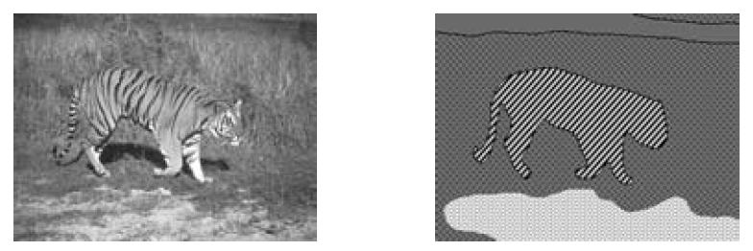
Segmentation
Segmentation: partition image into separate objects
Basic techniques:
  Boundary detection
  Clustering (e.g., vector quantization, Lloyd algorithm, GPCA)
(Courtesy of Jana Kosecka)

Slide 5




Recognition
Recognition: given an image, classify what object it represents
  Face/object recognition
  Digit recognition
  Activity recognition
  Pattern recognition, machine learning techniques

Slide 6
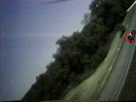
Object Tracking
Download “Tracker” from http://cs.gmu.edu/%7Ekosecka/cs682/Tracker.tar
Description: Given a sequence of images, the program will automatically detect feature points (points with high contrast) and track them across the image.
Could be your course project.
Demo: Point_Click_Tracking.avi

Slide 7
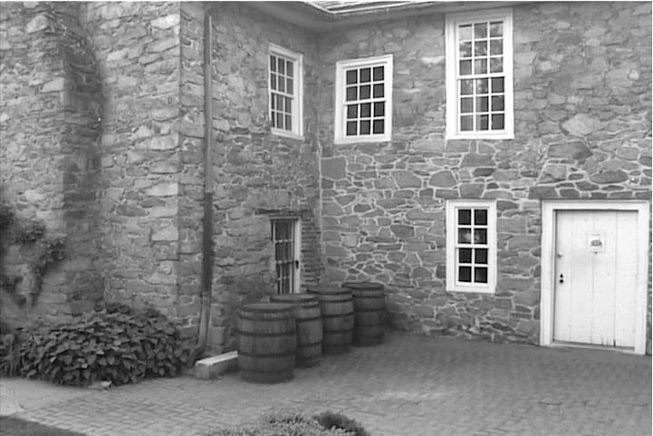
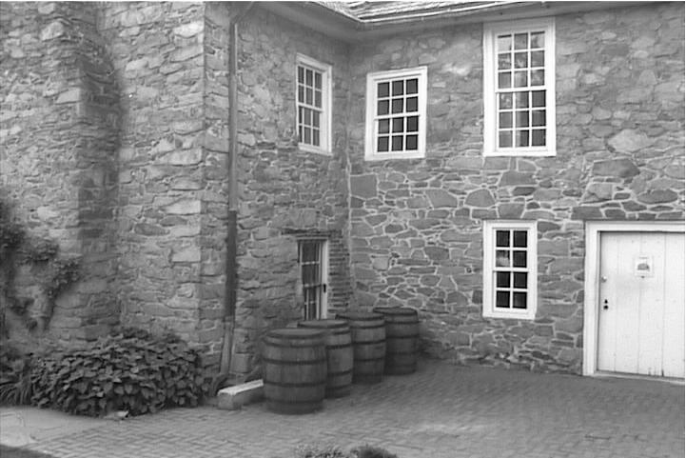
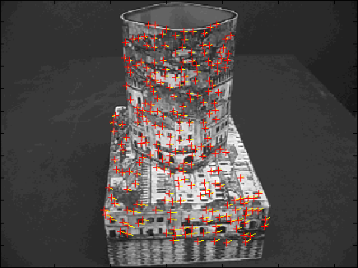
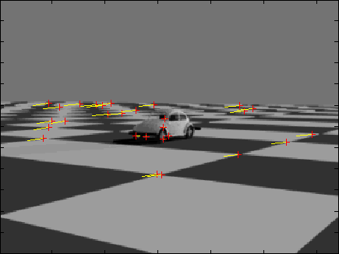
Feature Selection and Correspondence
Courtesy of Taoran Lu

Slide 8
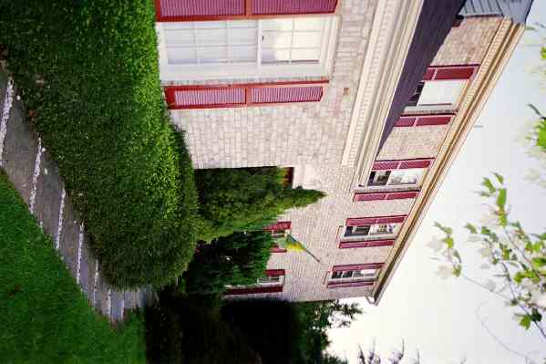
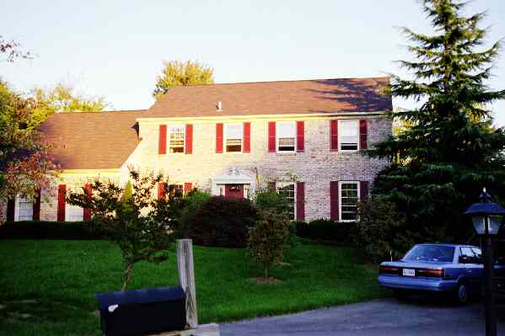
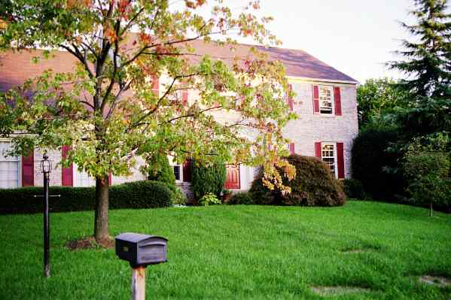
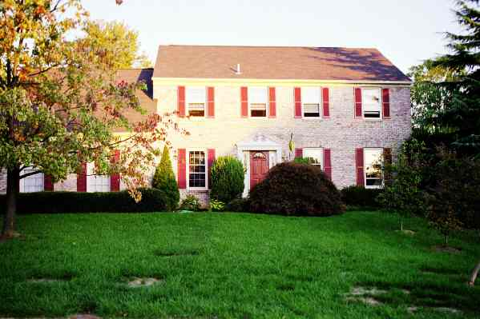

Reconstruction from Multiple Views
Input: Corresponding “features” in multiple perspective images.
Output: Camera pose, calibration, 3D scene structure representation.
(Courtesy of Jana Kosecka)

Slide 9

Structure from Motion
Given a sequence of images captured by one camera, construct 3D structure (height, width, depth/distance) of the objects.

Slide 10
Applications of Computer Vision Techniques (1)
Vision based control (unmanned air vehicle, unmanned ground vehicle, unmanned underwater vehicle)
Mobile robot navigation
Industrial inspection (automated systems for manufacturing)
Surveillance for home, bank, school, airport, hotel, stadium; border control, military intelligence
Medical image analysis

Slide 11
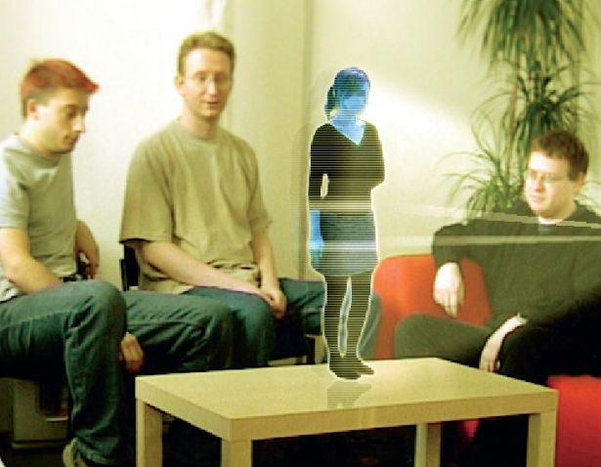
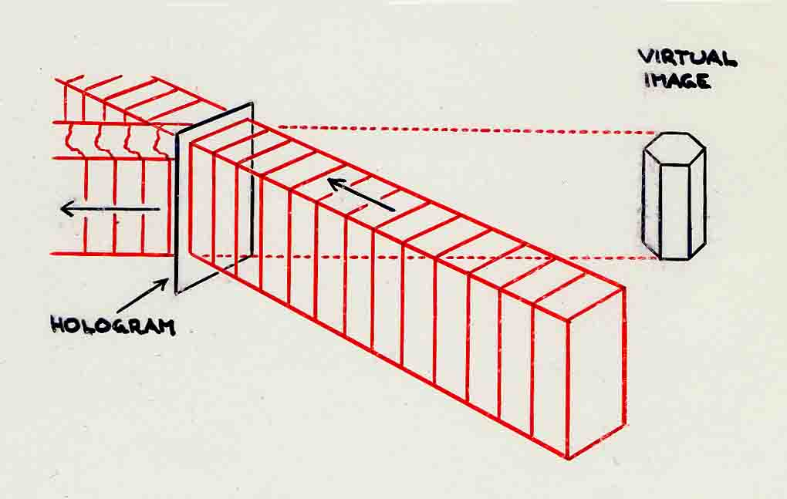
Applications of Computer Vision Techniques (2)
Human computer interaction (rendering depends on view angle, and distance of the viewer): simulate 3D holograph

Slide 12
Applications of Computer Vision Techniques (3)
Virtual reality
Image retrieval in image libraries
Video analysis
Image based rendering (view interpolation)
Realistic render of synthetic scenes in computer graphics

Slide 13
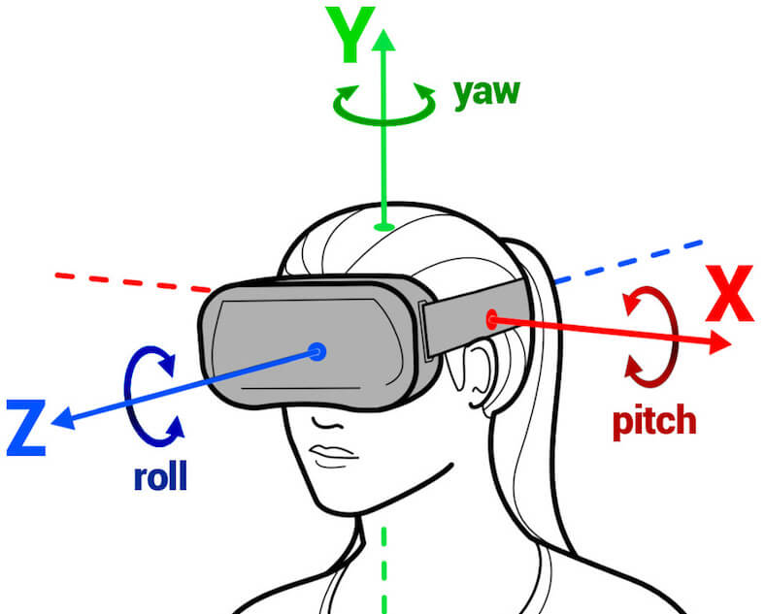
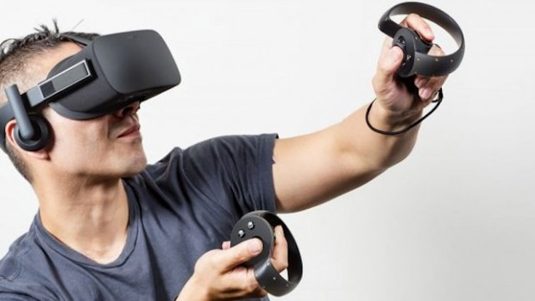
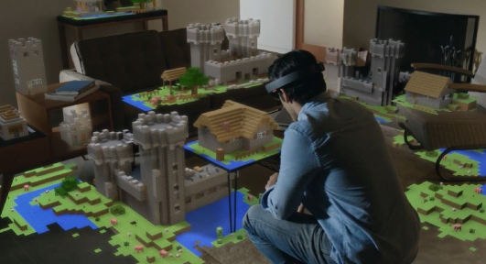
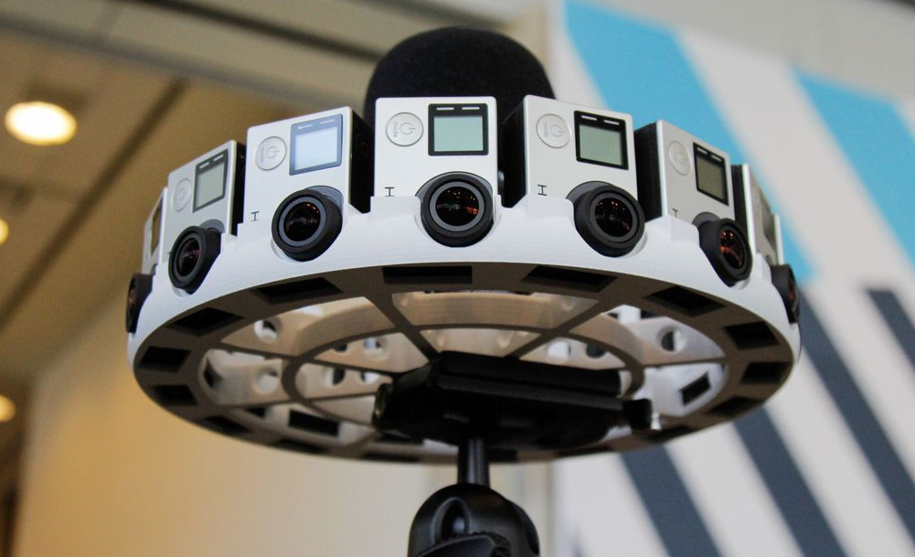
Virtual & Augmented Reality
6DoF head tracking
Hand & body tracking
3D scene understanding
3D-360 video capture

Slide 14
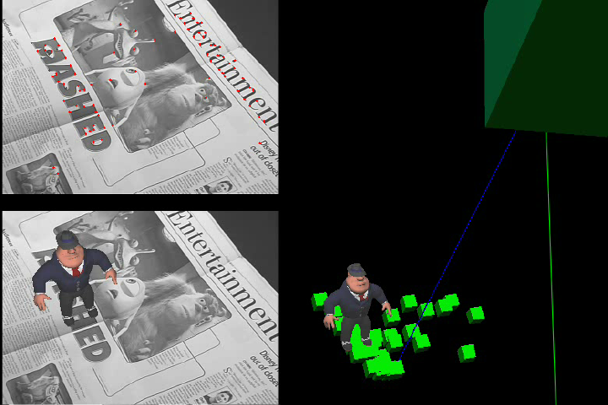
APPLICATIONS – Real-Time Virtual Object Insertion
UCLA Vision Lab

Slide 15
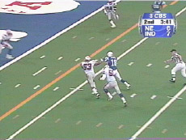
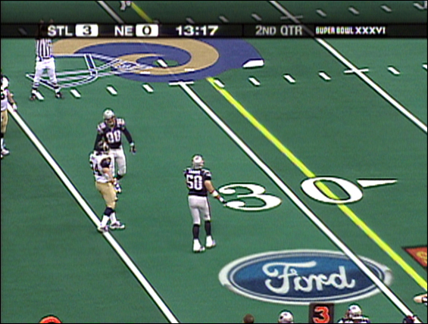
APPLICATIONS – Real-Time Sports Coverage
First-down line and virtual advertising
Princeton Video Image, Inc.

Slide 16
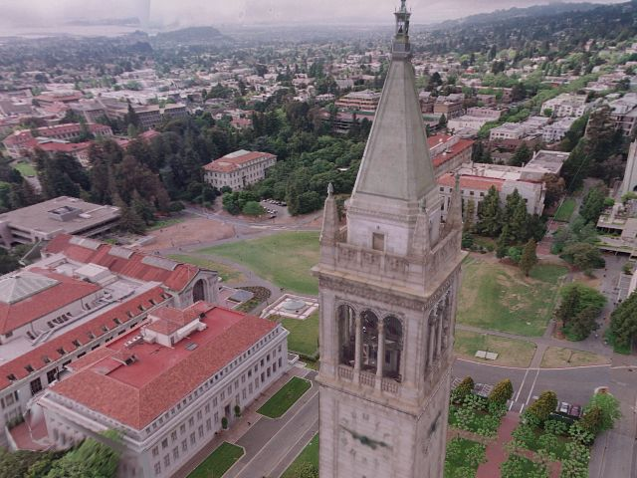
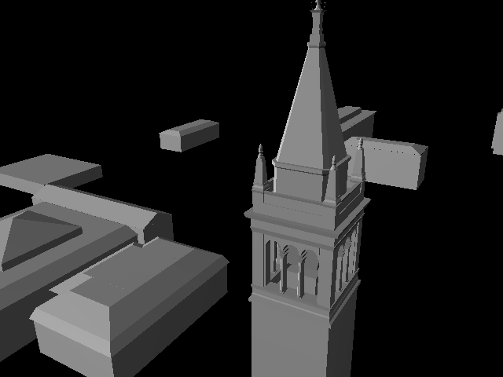
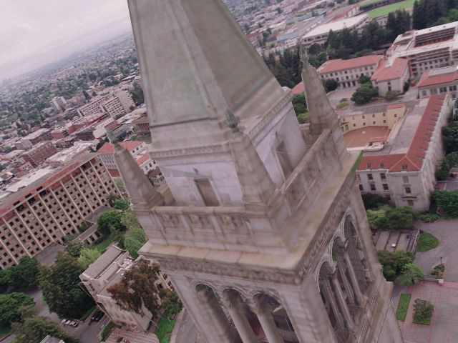
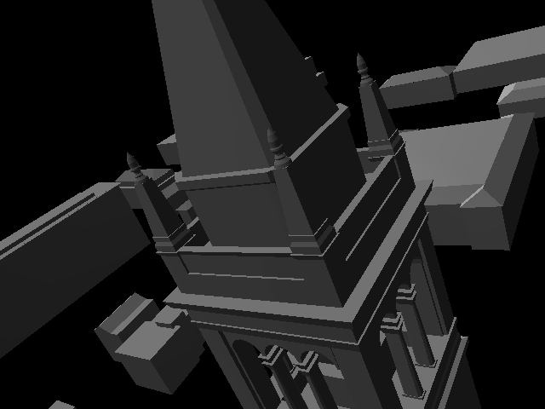
APPLICATIONS – Image-Based Modeling and Rendering
Image courtesy of Paul Debevec

Slide 17
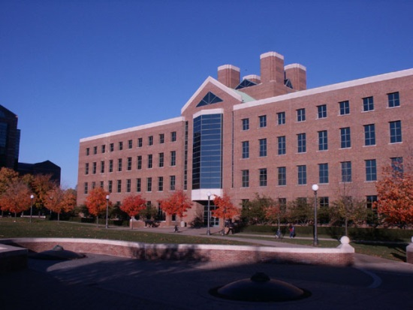
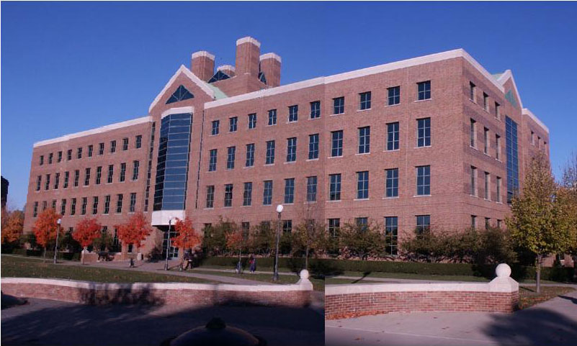
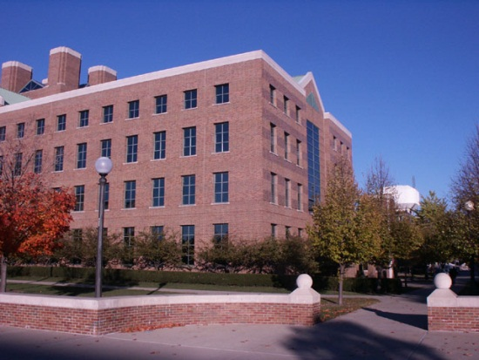
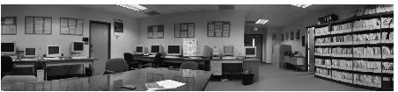
APPLICATIONS – Image Alignment, Mosaicing

Slide 18
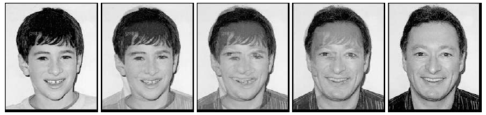
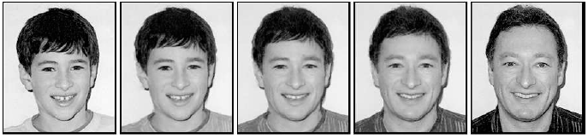
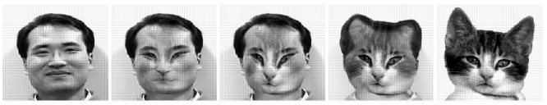
Image Morphing

Slide 19
Current state of the art
This is a very active research area, and rapidly changing
  More apps in the next 5 years??
To learn more about vision applications and companies
  David Lowe maintains an excellent overview of vision companies
    http://www.cs.ubc.ca/spider/lowe/vision.html

Slide 20
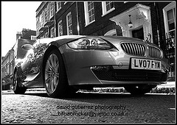
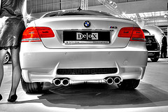
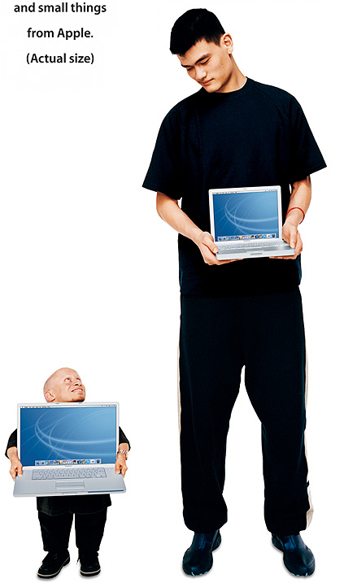

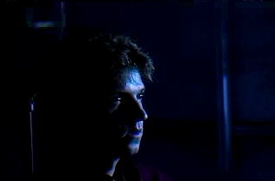
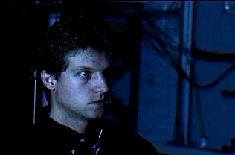
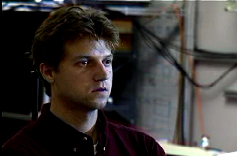
Why is computer vision difficult?
Viewpoint variation
Scale
Illumination

Slide 21
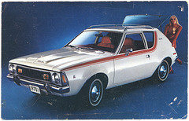
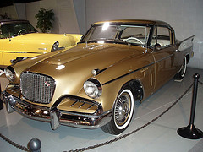

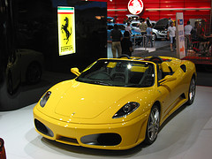


Why is computer vision difficult?
Motion (Source: S. Lazebnik)
Intra-class variation
Background clutter
Occlusion

Slide 22
Scope
Robotics
Machine Learning
Human Computer Interaction
Image processing
Scene understanding
Motion analysis
Object recognition
Graphics
Medical Imaging
Computational Photography
Neuroscience
Multimedia

Slide 23
Outline
Brief introduction
Syllabus

Slide 24
Grading
Grades | Percentage | Due Dates
Homework assignments | 30% | To be announced
Project | 20% | 4pm, Dec. 4
Final exam | 50% | Dec. 7 -- 19

Slide 25
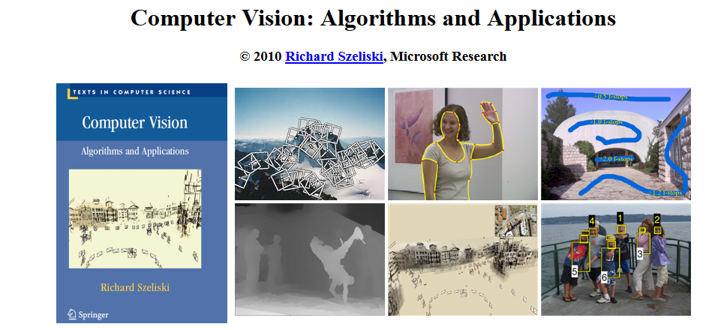
Course Textbook
There is no textbook for the course.
Use the following free book as a reference.
http://szeliski.org/Book/

Slide 26
Recommended Reading
Notes on web site: http://cs.gmu.edu/%7Ekosecka/cs682/handouts.html
Yi Ma, Stefano Soatto, Jana Kosecka, S. Shankar Sastry, "An Invitation to 3-D Vision," Hardcover: 526 pages ; Publisher: Springer-Verlag; (November 14, 2003) ISBN: 0387008934
  Chapters 2, 3, and 5 can be downloaded at http://vision.ucla.edu//MASKS/chapters.html
David A. Forsyth, Jean Ponce, "Computer Vision: A Modern Approach," Prentice Hall; 1st edition (August 14, 2002), ISBN: 0130851981.
Richard Hartley, Andrew Zisserman, "Multiple View Geometry in Computer Vision," Paperback: 672 pages ; Publisher: Cambridge University Press; 2 edition (March 25, 2004) ISBN: 0521540518

